Slide 1


Unlock Hidden Value

Slide 2
<Give it a Title>
IMPACT CASE STUDY

Slide 3
The Challenge
THE CLIENT:
RELATIONSHIP VIA:
<Anonymized Descriptive Company Name>
<Anonymized Descriptive PE Name>
The client had grown through rapid M&A and each brand used its own mix of suppliers. The absence of a centralized procurement function hindered access to vital contract and purchasing data. Longstanding supplier relationships added to the challenge of consolidating and optimizing third-party spending.
Our Approach
The client had grown through rapid M&A and each brand used its own mix of suppliers. The absence of a centralized procurement function hindered access to vital contract and purchasing data. Longstanding supplier relationships added to the challenge of consolidating and optimizing third-party spending.

Slide 4
Key Levers
Value Delivered
Optimized existing supplier relationships by leading data-driven incumbent supplier negotiations
Employed competitive processes where appropriate to secure best-in-class commercial terms
Created a model to assess procurement synergies for ongoing and future M&A
$3M in savings
on critical COGS categories
$3M additional savings
Identified for a bolt-on acquisition
Our Differentiators
Optimized existing supplier relationships by leading data-driven incumbent supplier negotiations
Employed competitive processes where appropriate to secure best-in-class commercial terms
$60M value created

Slide 5
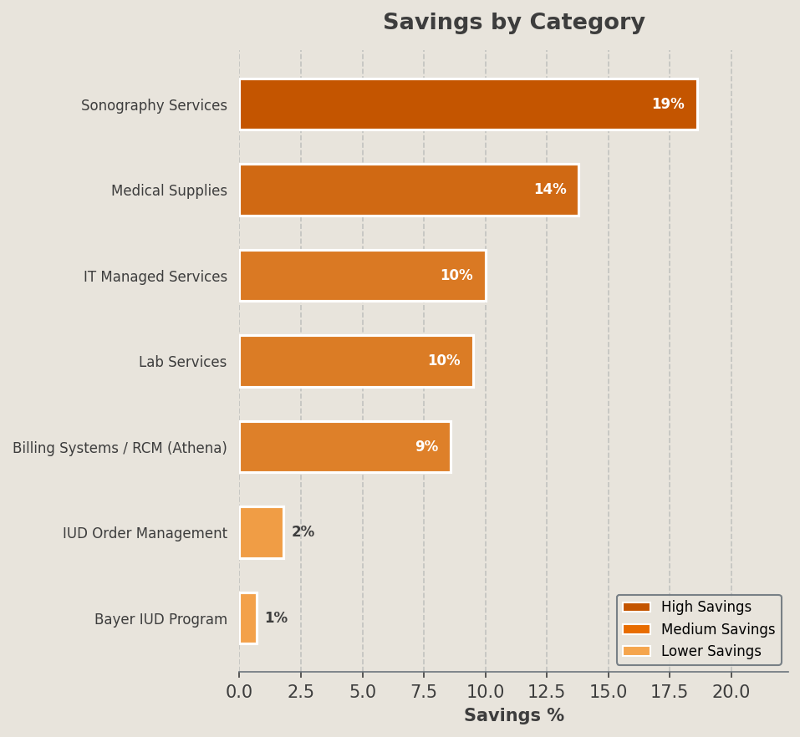
Selected Category Outcomes
Category | Incumbent Vendors | Awarded Vendors | % Savings | Key Lever(s)
IUD Order Management | Bayer | Bayer (USWHA tier discounts activated) | $3,140,334 | Policy enforcement of 5-unit minimum order, Volume aggregation
Bayer IUD Program | Bayer | Bayer (Confidence in Coverage replacement program) | $3,140,334 | Supplier rebate program enrolment, Behavioral change – claim replacement utilisation
Billing Systems / RCM (Athena) | Athenahealth (athenaOne) | Athenahealth (renegotiated 3.15% fee tier) | $3,025,000 | Benchmark-driven renegotiation, Tiered fee reduction
Medical Supplies | Medline (Heartland region), McKesson (Mid-Atlantic) | McKesson (enterprise-wide primary distributor) | $1,133,051 | Competitive RFP, Distributor consolidation
Sonography Services | IT Imaging | In-house recruiting model (Advantia HR), Staffmark (Recruiter-on-Demand 20 % utilisation) | $819,732 | Make-versus-buy analysis, Staffing model change
Lab Services | LabCorp (incumbent) | LabCorp (renegotiated pricing) | $423,792 | RFQ with BAFO rounds, Incumbent benchmarking
IT Managed Services | DAG Tech, ComTech Systems |  | $314,588 | Benchmarking, RFP

